Slide 1
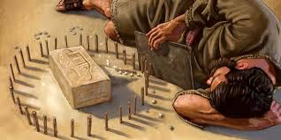
Ezekiel 4-5
"The Siege"

Slide 2
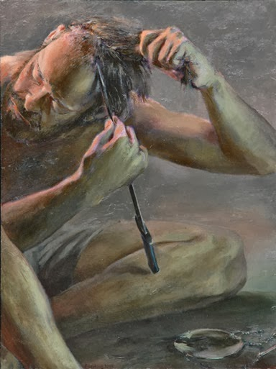
THE SIEGE (4:1-5:4)
Siege Operations (4:1-3)
Siege Duration (4:4-8)
Siege Conditions (4:9-17)
Siege Results (5:1-4)

Slide 3
EXPLANATION OF THE SIEGE (5:5-17)
Reasons for the Siege (5:5-12)
God gives reasons….
Results of the Siege (5:13-17)
What effect on God?
What effect on "the nations"?
What effect on the inhabitants of Jerusalem?

